Slide 1

Exploring Stock Market Strategies with Risk and Influence with Complex Networks
Rachael Judy, Connor Klein, Josh Smith

Slide 2
Project Status
Project objective of exploring the impact of different risk strategies on portfolio returns
Also exploring how differing levels of influence from neighbors affects returns in terms of number of neighbors
Currently running with 100 brokers connected as discussed with risk assigned with the option to update portfolio every step
Current tests not definitively showing impact of influence amongst neighbors
Can see difference in fluctuations between risky and less risky strategies
Notes:
Project objective of exploring the impact of different risk strategies on portfolio returns – have a power law distribution of risk with k=3 for fat tailed distribution using the dividend rate, the fifty day average, the 52 week high and low, the forward eps, and portfolio allocation with allocation and eps for coefficient and the stats over time in the exponent; brokers are set up so lower number ids have lower risk and higher
Also exploring how differing levels of influence from neighbors affects returns in terms of number of neighbors – assigning number of friends with a power law distribution; which friend is chosen according to a normal distribution spread over the brokers with brokers in the middle highest probability; increasing the strength of recommendations for risk based on neighbor’s success has thus far not shown huge impact
Expanding on the strategy: runs the 100 brokers over 10 years, feeding the aforementioned data for every day and trying to keep risk between a minimum and maximum level with risk assigned based on the prior factors to each purchase/sell; preliminary tests over 2003-2010 to capture the 2008 financial crisis and see how the different risk preferences do
Was hoping to see certain strategies do well normally but then others do better during the crisis event but currently not a clear development
Current work still in progress – have some missing data so stock statistics were assumed to be average for initial test, risk function doesn’t perfectly capture nature of positive and negative risk, bugs in simulation with a good number of brokers not doing the expected baseline increase over time, runtime limits amount of years the simulation can be run over

Slide 3
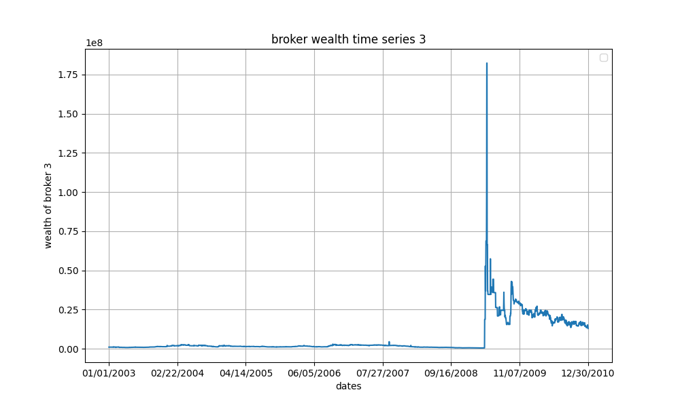
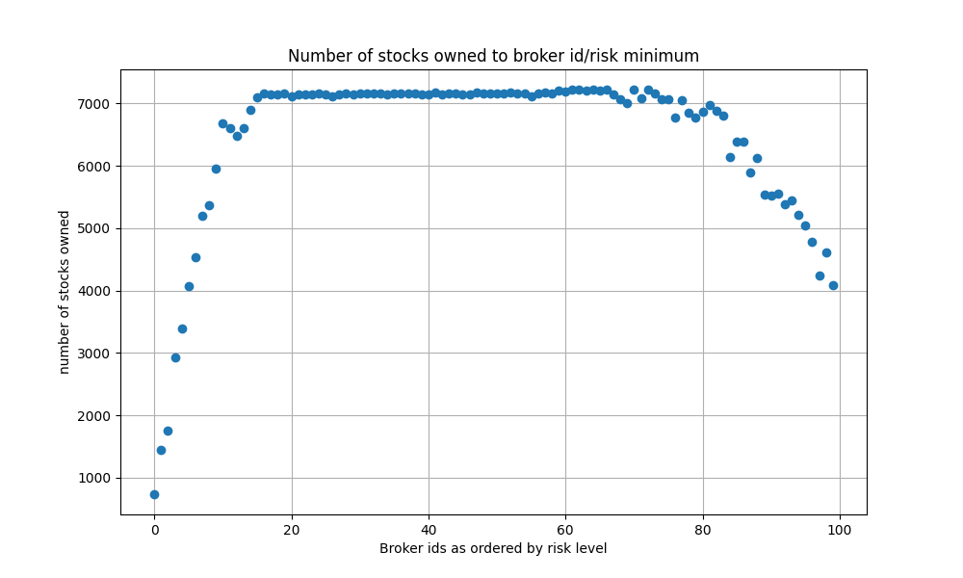
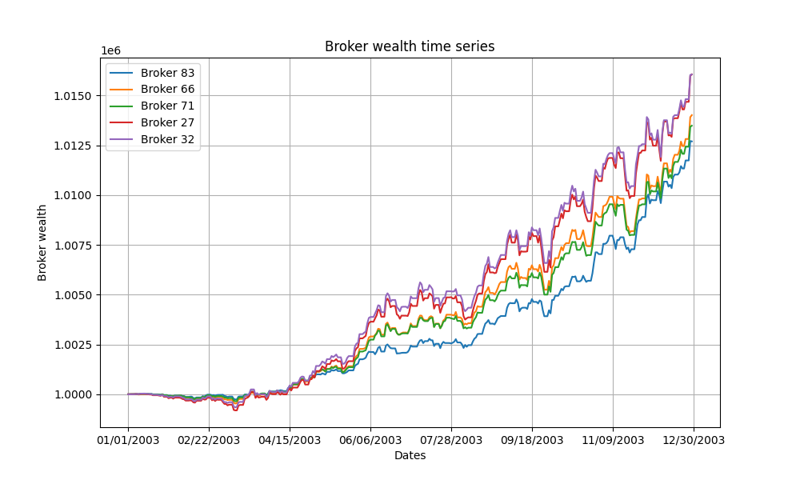
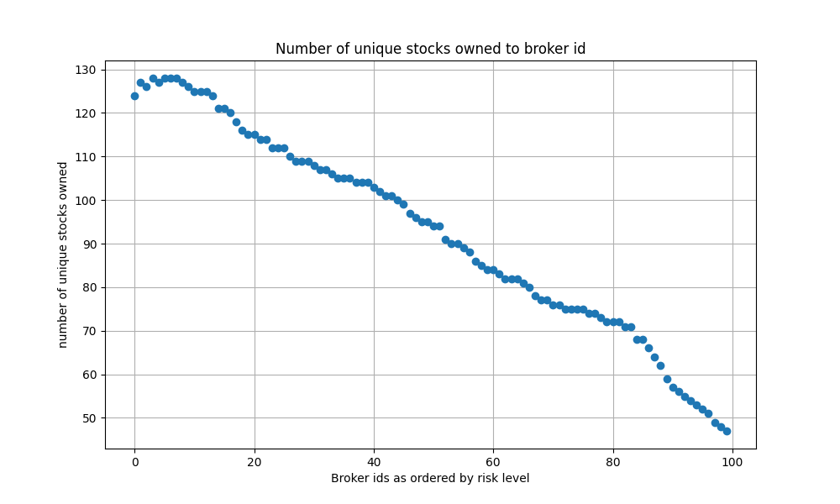
Notes:
Seeing impact of risk in play currently; y axis is dollars, x axis is dates.
A further example on left of the broker wealth with a low risk strategy, very little change in portfolio value over the first few years
This model at least has some validity as it has the spike that happened after the financial crisis and showed how profits could be made by buying at the drop
Note how the broker ids, which increase preference for risk as going to the right as briefly previously discussed, tend to have less unique stocks and less stocks in general at high risk. These end up with all their money on a few expensive stocks
Conservative strategies tend to own more stocks in more categories. This demonstrates the risk functionality

Slide 4
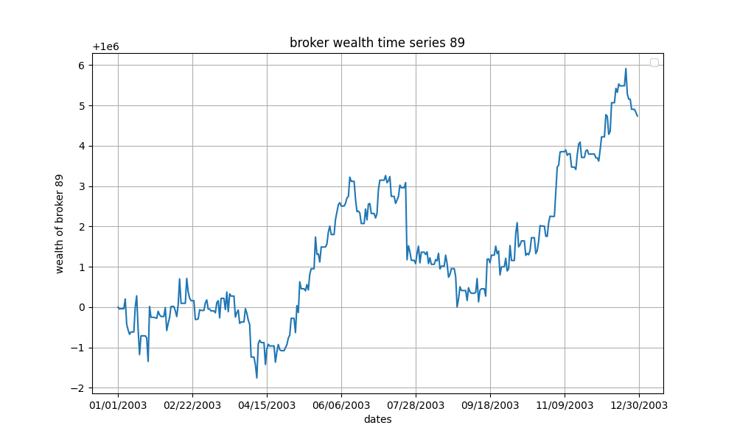
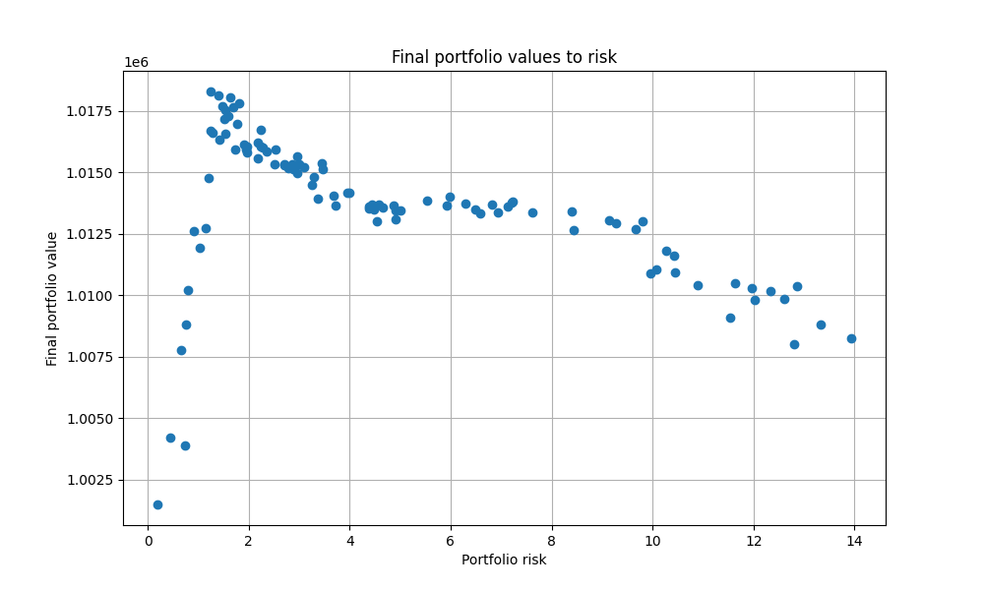
Notes:
Left shows a moderately high risk broker making money over time, just exploring how their portfolio fluctuates; the value is determined based on the price of stocks owned if they were to be sold on a given date plus the liquid currency at this point
However, the different risk behaviors weren’t showing a huge difference over a ten year period on the right 2003-2013; may be due to some bugs in the way data collection is setup

Slide 5
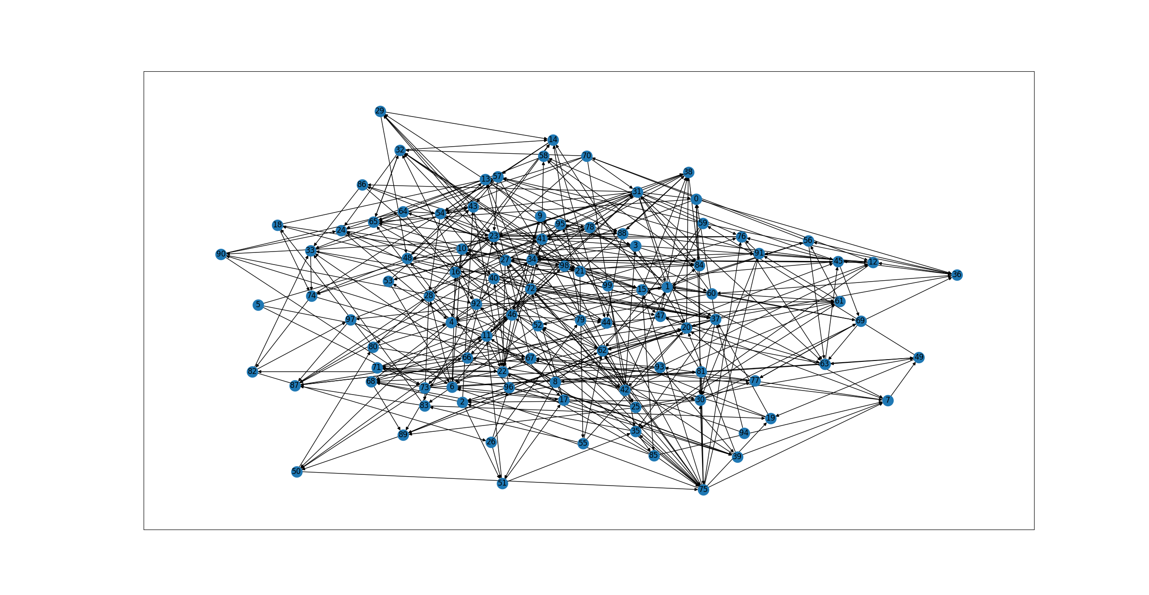
Notes:
Graph of the broker network being used at the end after successful brokers connections strengthen, can see that middle numbers have the most connections and those connections are stronger
Possibly don’t include this slide, the testing I’ve gotten so far hasn’t indicated anything particularly definitive or interesting about the influence

